Slide 1
Information Session
Grants Hotel Roscrea

Slide 2
Funding purpose
Funding was provided under the Town and Village Renewal Scheme Project Development Measure 2024 as a pilot enhanced scheme.
Detailed feasibility study for Grant’s Hotel Roscrea Co Tipperary with all potential and relevant design, planning and ancillary requirements.
It is expected that the study will be based on a collaborative approach with the local community and stakeholders and will seek to advance the spirit of Our Rural Future and the national Town Centre First Policy.

Slide 3
Objectives
Boost tourism activity within the town;
Increase footfall and dwell time within the town centre;
Cater for the local community & provide employment opportunities;
Facilitate a complementary mix of uses across the site;
Stimulate the night-time economy within Roscrea;
Celebrate and re-connect with the heritage of the site;
Utilise the site’s location to create linkages between key heritage assets of the town;
Explore opportunities for town centre living;
Explore opportunities for placemaking and improved public realm.

Slide 4
Approach
1. Desktop Research: desktop review of current context of Roscrea, including relevant reports, planning policies, and strategic documents, such as the Town Centre First Plan.
2. Site & Market Analysis: A detailed analysis of the study site was undertaken, assessing
factors such as physical condition, accessibility, infrastructure, and environmental considerations.
In parallel, a market review was conducted to provide a demographic overview, local economic conditions, existing tourism landscape and demand analysis.
3. Stakeholder Engagement: A series of consultations were held with community representatives, local businesses, public agencies, elected officials and the wider local community to gather insights, understand priorities, and test emerging ideas.
4. Potential Uses & Concept Development: A list of potential site uses was developed through
research and stakeholder engagement. This was refined into a core set of viable uses, reflecting local needs and strategic priorities. These informed the development of three distinct concept design options, each testing different site configurations and spatial arrangements. The options were evaluated against criteria including policy alignment, planning considerations, and environmental performance.
5. Financial Feasibility: The final stage involved a high-level financial appraisal of the three concept design options. This included cost estimates, potential revenue streams, operational costs and economic impact.

Slide 5
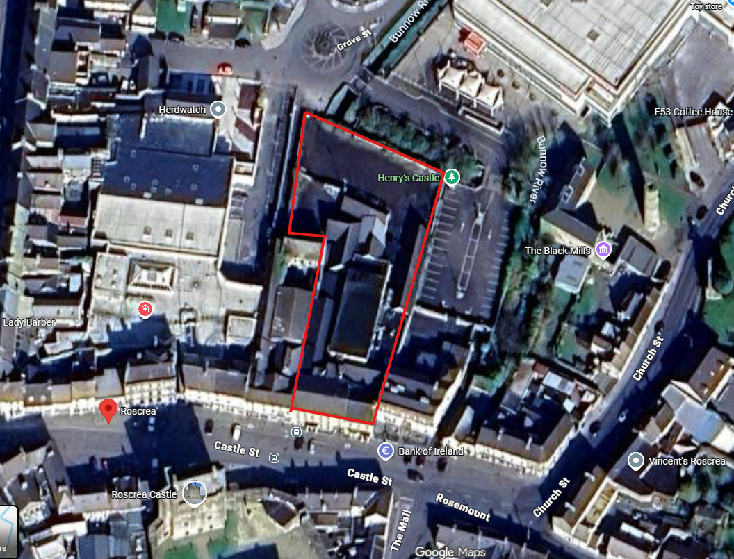
Grant’s Hotel (The Damer Rooms)

Slide 6
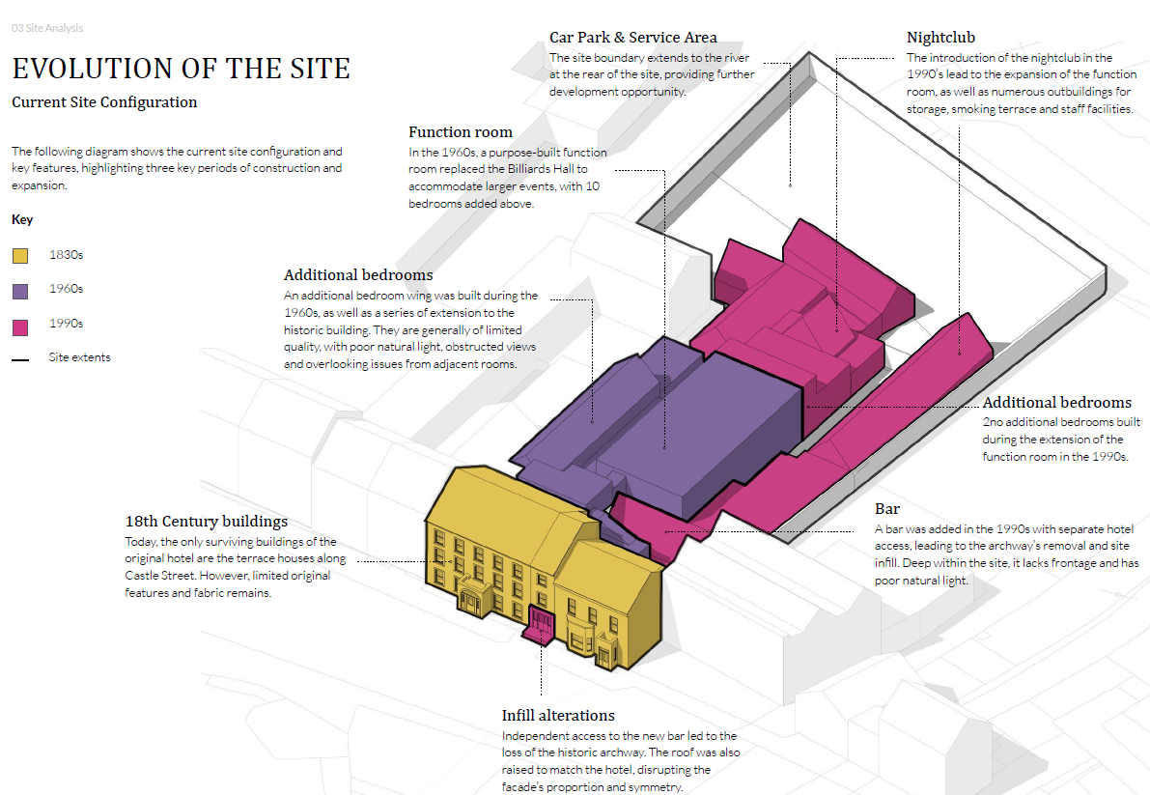
The Site

Slide 7
Market Analysis
Accommodation in the Roscrea area is currently lacking which is a position mirrored across the
county. A November 2023 Tipperary accommodation audit identified a shortfall in capacity compared to demand, referencing a need for additional accommodation to support the county’s tourism potential.
Hotels account for 61% of available accommodation in Tipperary, with most rooms located in
Clonmel, Thurles, and Nenagh. Clonmel and Thurles all of which are a reasonable distance from
Roscrea, limiting accommodation options in the northern part of the county. Furthermore, at this
time, Racket Hall, a 40-room hotel in Roscrea, was operational as a hotel.
At a County level, Failte Ireland visitor statistics for Tipperary show that in 2019, it welcomed 470k
visitors, with 59% domestic, and 41% out of state . Pre-Covid, the sector data indicated that tourism
supported over 3,000 jobs in the County. No up to date is available for the County.
Roscrea is included within the “Hidden Heartlands” which is a Failte Ireland tourism initiative to
support the wider region.

Slide 8
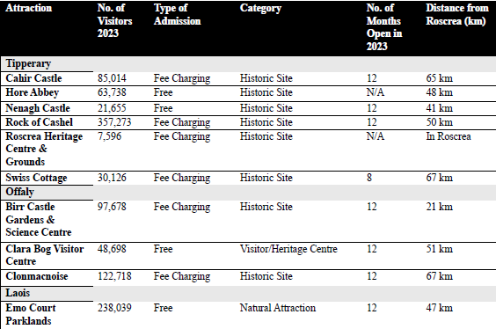
Tourist numbers

Slide 9
Need for community facilities
While there are several community spaces within the town centre area, consultations undertaken as part of Roscrea Town Centre First baseline planning report identified a potential to improve the
events spaces. Feedback indicated a need to diversify and improve community facilities and launch initiatives that can create a greater sense of community pride and enhance quality of life for residents. This has been further emphasised through the consultations undertaken as part of this study.
It was noted that there is nowhere for functions or family events such as weddings, christenings,
funerals etc and no social space for the community to share. This was strongly voiced throughout the consultation process along with the belief that the town does not have the appropriate infrastructure to cater for its community.
Compared to the county and the state, Roscrea has a higher-than-average mix of under 19 year olds and over 60 year olds but a lower percentage of 20-59 year olds. It is important that the appropriate amenities and services are created within the town in order to create opportunities for employment and social inclusion, to retain the youth and build for the future.

Slide 10
Market Need
It is evident that there is clear potential to improve the tourism offering within Roscrea but
acknowledged that this market is not currently developed and cannot be evidenced. It’s proximity to other attractions that are consistently reporting high visitor numbers, the impact of significant
investments which are imminent at Roscrea Castle, together with the proposed development of the Greenway and Butler Trail, will all have a direct impact on the attractiveness of Roscrea to tourists and will help improve the tourism potential over time.
However, it will take time to develop this market and therefore the success of any hotel development project will be contingent on the community support for the project. Market research undertaken as part of this study has concluded that there is demand for a quality restaurant to open up the night-time economy and for a function space that has host local family and social events to service both the local community and those from surrounding regions.
There is also a clear need for more community services to cater for the growing population.

Slide 11
Stakeholder Views – key findings
● Mixed-Use Viability: The existing tourism market in Roscrea and the wider region may not
sustain a hotel on its own. A mixed-use development incorporating complementary uses
would enhance viability.
● Heritage & Connectivity: The site’s rich history and prime town-centre location should be
leveraged as a key differentiator. Strengthening links between the Castle, Black Mills, and
Round Tower could create a cohesive heritage corridor, enhancing the town’s cultural appeal.
● Diverse Accommodation: Exploring alternative accommodation options, such as self-catering
units, could attract a broader audience.
● Importance of the Visitor Experience: Prioritising quality over quantity in accommodation
offerings is key to positioning the site as a unique and desirable destination. Rather than maximising bed numbers, a curated, high-quality offer - integrated with the town’s heritage, culture, and landscape - can appeal to niche markets such as heritage tourism, wellness retreats, or boutique hospitality.
● Town Activation & Economy: A well-positioned restaurant could stimulate
activity along Castle Street and support the night-time economy. Additionally, there is a need
for a centrally located community gathering space for events such as weddings and funerals,
which are currently held on the town’s outskirts.
● Business & Enterprise: The town’s business and enterprise needs are anticipated to be largely
being met by the REACH development, allowing this site to focus on tourism, heritage, and
community-orientated uses.

Slide 12
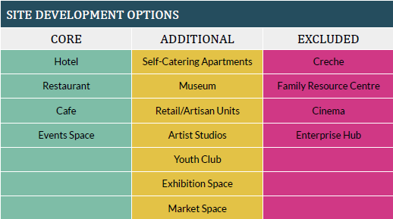
Potential Uses
● Core options are essential to the future operation of the site.
● Additional options enhance the site’s offering but are not fundamental.
● Excluded options were deemed challenging to implement and integrate as part of the
feasibility study, due to site location and constraints, incompatibility with a tourism
and hospitality ‘public’ focus, and/or limited financial and market appeal. However, given the scale of the site, some of these options may be appropriate as a standalone development to the rear.

Slide 13
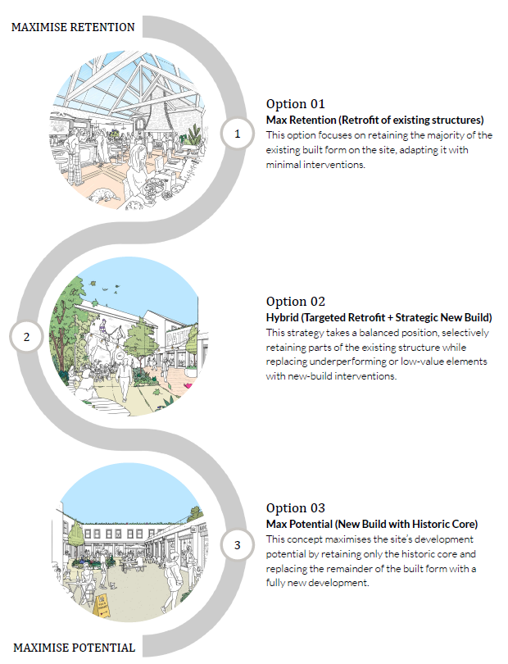
3 most viable options

Slide 14
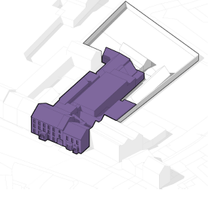
Option 1 – maximum retention
The existing building to undergo a sensitive restoration to meet modern building standards, with alterations to internal layouts limited where possible.
Core Activities:
Hotel: 24 bedrooms
Restaurant: 26 covers
Bar: 215m2
Events Space: 208 seats (banquet)
Estimated capital cost: €5,167,597

Slide 15
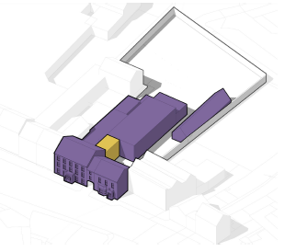
Option 2 - Hybrid
Demolition primarily focused on the 1990s additions, including the bar and storage buildings to the rear of the site. The remaining structures undergo significant retrofitting, including façade restoration work to revive original character and appearance of historic building.
Core Activities:
Hotel: 21 bedrooms
Restaurant: 74 covers
Bar: 40m2
Events Space: 185 seats (banquet)
Estimated capital cost: €5,514,170

Slide 16
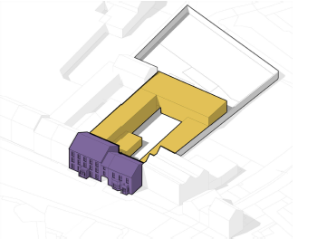
Option 3 – maximum potential
Later 20th-century additions are removed, preserving only the historic 18th/19th-century structures along Castle Street. A new mixed-use development is introduced with a large, central courtyard. Conservation efforts are focused on
the reviving the original character of the historic buildings.
Core Activities:
Hotel: 10 bedrooms; 7 self-catering apartments
Restaurant: 62 covers
Bar: 40m2
Events Space: 120 seats (banquet)
Ground floor units: 226m2
Estimated capital cost: €7,611,077

Slide 17
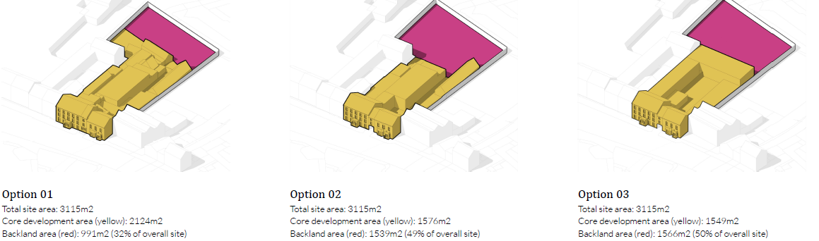
Potential of back land site
Due to the overall scale of the site, there may be an opportunity to zone the rear backland area (indicated in red below) for alternative uses - such as a community facility or uses excluded during the options appraisal section of the report, such as a stand alone creche. This potential is particularly relevant in Options 02 and 03, where a reduction in the existing building footprint increases the backland area to approximately 50% of the total site.
As a result of the complexities to be considered, the financial analysis not incorporate any further development of the backland site, but it is recognised that this could be explored depending on how the project is being taken forward.

Slide 18
Revenue Drivers
It is evident that whilst there is clearly potential to grow the tourism market in Roscrea, which will be boosted with the significant projects that are in progress with the Castle, public realm improvements in Market Street and the REACH Enterprise Hub, in addition to celebrating the rich heritage of the town, the market is still underdeveloped and this is reflected in the assumptions used for the financial analysis.
There is a demonstrable need for a facility that will both serve the needs of the community and will be available for tourists as and when the tourism market develops further.
The elements that have been incorporated into each option which will be key revenue drivers are a good quality restaurant and a function room that can service weddings, christenings, family events and concerts, with these in turn having the potential to create a demand for the bedrooms.
Whilst it is acknowledged that the occupancy rates and Average Daily Rate (ADR) will increase
as the market develops, the following assumptions are based on current market demand as unless the hotel is viable from the outset, it will not survive to enable the market to develop.
Therefore there is a need for strong community support for the hotel from the outset.

Slide 19
Financial Assessment
The below table indicates potential Financial Viability based on assumptions made, for 2 of the 3 Options assessed, with 2 variations being considered for Option 3 based on the utilisation of the 1-
and 2-bedroom apartments.
It should be noted that no debt has been incorporated into any of the above options. The annual loan commitments for a €5m loan to be repaid over 20 years @ an interest rate of 6% p.a. would be c.€440k per annum which is clearly not affordable at the beginning.

Slide 20
10 year outlook
It is important to note that the above calculations have been based on a low occupancy rate for the hotel accommodation of 40% for Option 1, 45% for Option 2 and 70% for Option 3 due to the smaller number of rooms which is reflective of the current market positioning. (Self catering shown at 50% in Option 3B). However, should the potential growth in the tourism market be realised over the next 10 years, the financial platform is transformed.
Option 1 is forecast to be loss making throughout due to the inefficient layout, restricted restaurant, limited access etc. Options 2 and 3B have been taken forward for comparison and these present more potential for the hotel to be run as a commercial enterprise. Both show that the hotel would be able to service reasonable debt after a 5-year period if the above assumptions are realised.

Slide 21
20 year outlook – economic impact
All show that there is an overall economic impact with Option 2 presenting the highest Economic
Impact/ economic impact over a 20-year period.
This incorporates additional tourism revenue brought to County Tipperary as a result of the new
hotel and community offering, and additional spend in the local economy on local purchases to
service the hotel as well as the potential for additional rates income for the Council.
It is acknowledged that funding the proposed hotel project will likely be challenging. For any such
operation to be attractive to developers or hotel operators, financial viability should be evidenced.
Whilst the initial forecasts prepared show operational viability for Options 2 & 3, this is before any
debt repayment has been taken into consideration.

Slide 22
Conclusion
This feasibility study had examined the potential to reopen the former Grants Hotel which closed for business in 2013. Until recently, there was a second hotel operating in Roscrea, but this was
repurposed in 2023 and now there is no approved tourism accommodation available to service both the community and tourism within the town.
Research has shown that in other towns across Ireland, there are numerous rural hotels that are
sustainable mainly due to servicing the local community through the provision of a quality restaurant and a function room that could service family events, music events etc. Accommodation is somewhat of a secondary revenue stream and is not the key contributor to revenue.
It is believed that given the scale of the project and the lack of an active tourism market that can be evidenced at present, that it may be challenging to attract private sector investment for the capital build. Consideration could perhaps be given to seeking public funds to cover the capital costs and thereafter, the project has the ability to be operationally viable with the right management team in place, perhaps through a public private partnership arrangement. Important to note that State Aid rules will apply. Furthermore, there is potential to recoup part of this investment once the market develops.
However this can only be delivered if the community fully support the project.

