Slide 1
Planning for an Increasing and Ageing Population
“If you design for the young you exclude the old, but if you design for the old you include everyone”
Glenn Millar, Director of Education and Research, Canadian Urban Development Institute

Slide 2
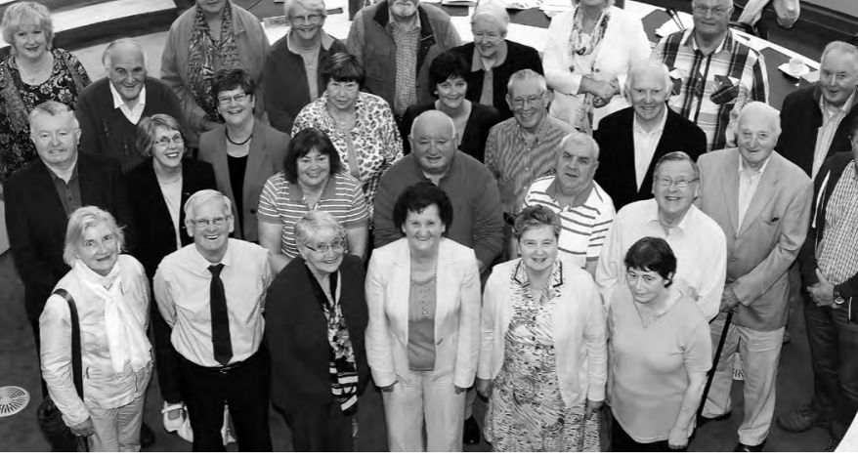
Finding the Voice - Older People’s Council

Slide 3
What is an Older People’s Council?
A representative group of older people, established by local authorities as part of the development of the Age Friendly City/County programme.
The group of older people identify priority areas of need, raise issues of importance and inform and influence the decision making process of the City or County Age Friendly initiative.
Representatives of Older People’s Councils participate, alongside representatives of the relevant member agencies, on the Age Friendly City/County Alliance.
The Older People’s Council provides a citizen or service user perspective in monitoring the implementation of City & County Age Friendly strategies.
The Older People’s Councils are representative of the diversity of the older population in the city or county, linked to local older people’s groups and supportive of the participation of the most marginalised.

Slide 4
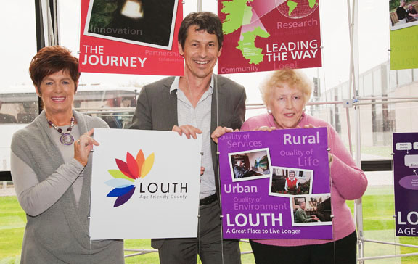
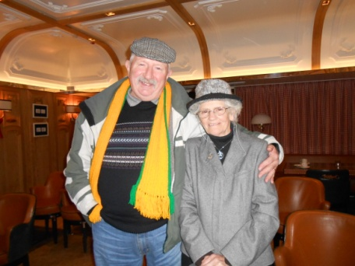
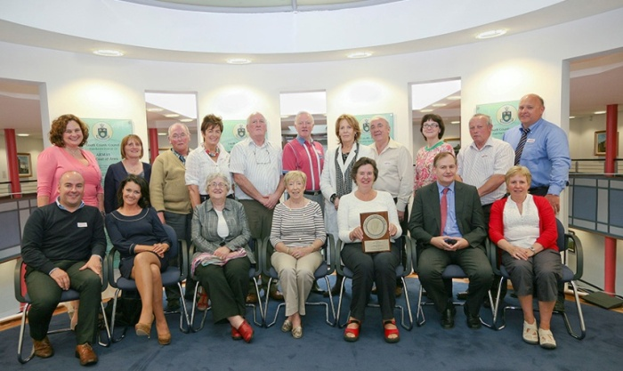
Participating and Influencing
Finding the voice - Representing ALL older people’s
Bottom up – informing the key decision makers
Solution focused
Executing the actions and being key to communicating with the wider community
Form cohorts of volunteers for related initiatives – Crime Prevention Ambassadors, Intergenerational Programmes
Two Tiers – Broader membership & elected executive
National Network of Older People’s Councils

Slide 5
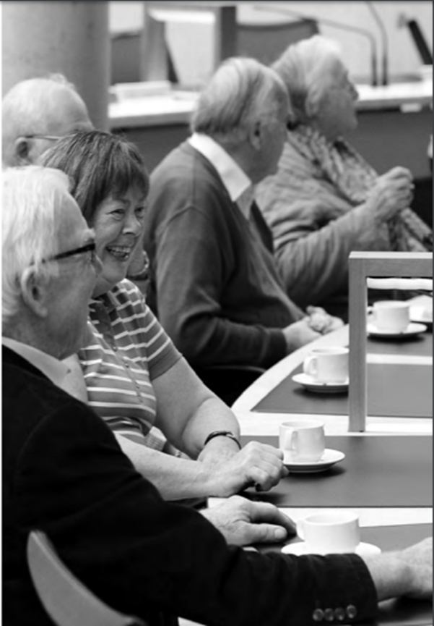
Setting up an Older People’s Council
To have a wide and diverse group of people on the Older People’s Council, it’s important to recruit members from four key groups.
Members of community and voluntary groups
Individual older people from aged 50 onwards,
Representatives of older people living in residential care homes
Representatives of more vulnerable older people who can be advocated for by formal/ informal carers and/or public health nurses.
Younger Older People
Minority Groups

Slide 6
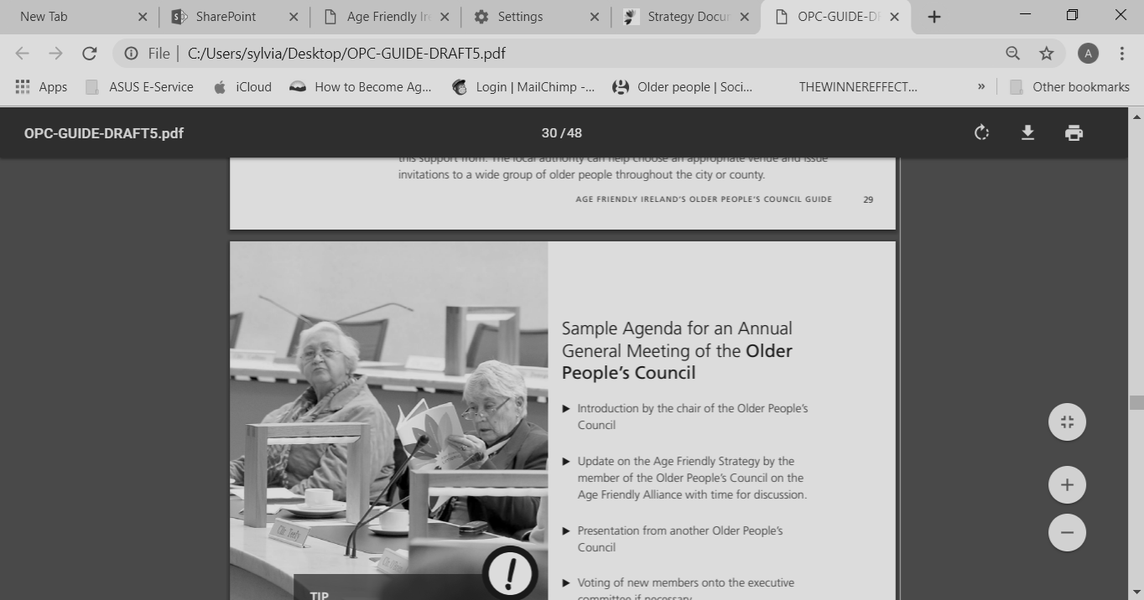
Running an Older People’s Council
Support | Establishing administrative support for the Older People’s Council.
Action | Create an annual plan of activity
Collaboration | Working with the Age Friendly Alliance
Participation | Taking part in Age Friendly initiatives in your city/county
Communications & Sharing | Annual General Meetings, regular communication through various methods

Slide 7
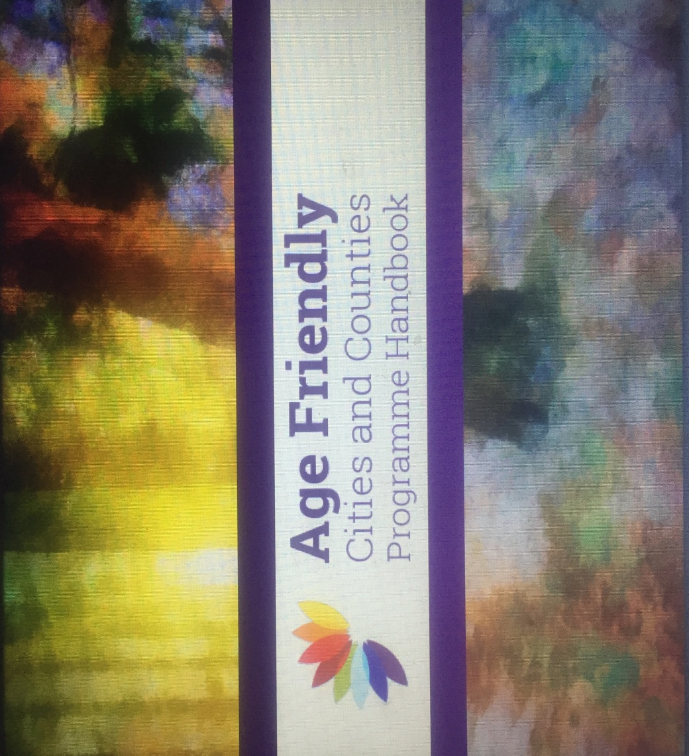
Age Friendly Framework
Promoting Inclusion
Creating Access
Equality for All
Promoting Partnership
Supporting Collaboration
Thinking Differently
Co Design & Innovation
Implementation
Sustainability
A model for all

Slide 8
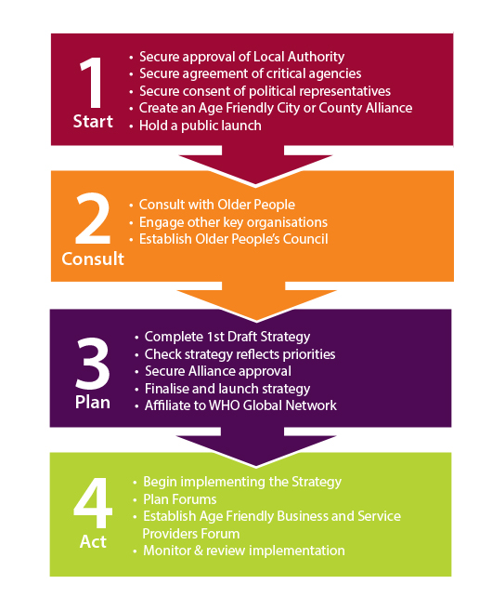
Adopting the Age Friendly Methodology
The 4 Stage Approach
Start
Consult
Plan
Act

